Slide 1
Deep Reinforcement Learning for Trading
Hao Wang, Haolan Cheng, Yuting Lun

Slide 2
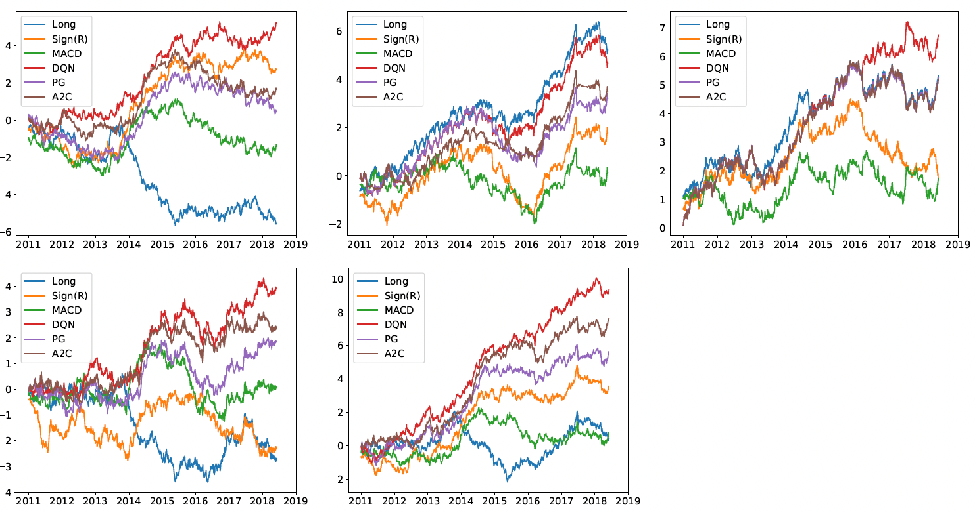
Summary of Original Paper
Traditional Methods
Proposed RL Methods
Fundamental & Technical Analysis: Often lack precise timing for entering and exiting trades, leading to potential drawdowns.
Time-Series Momentum: Highly effective in trending markets, but severely vulnerable to sideways or mean-reverting markets (like FX).
Classical RL (Q-Learning): Frequently relies on discrete action spaces (fully long/short), which is highly risky during volatile periods.
Deep Q-Networks (DQN): Evaluates the value of discrete actions in a given state.
Policy Gradients (PG): Optimizes the policy directly, useful for continuous action spaces.
Advantage Actor-Critic (A2C): Updates policies in real-time by combining an 'actor' network with a 'critic' network.
Figure 1: Cumulative trade returns.
First row: commodity, equity index and fixed income;
Second row: FX and the portfolio of using all contracts.

Slide 3
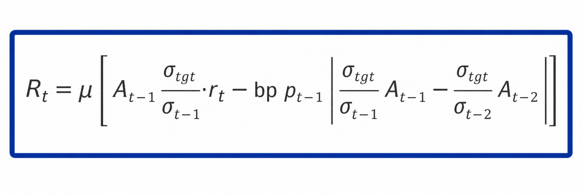
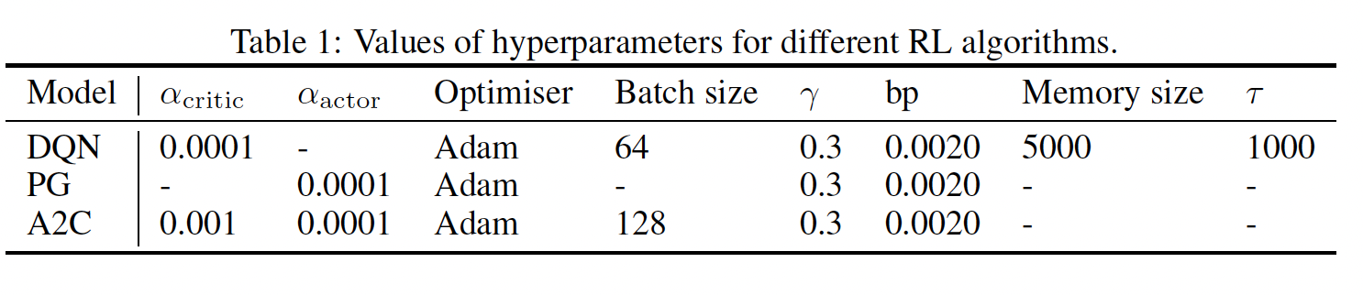
Summary of Original Paper
1. Data
2. Methodology
3. Evaluation Metrics
50 most liquid futures contracts (2011-2019).
Commodities (25)
Equity Indices (11)
Fixed Income (5)
Forex (9)
Markov Decision Process (MDP) formulation.
State: 60-day lookback (Price, Returns, MACD, RSI).
Action: Target orders [-1, 1].
Reward: Volatility-scaled additive profits.
Portfolio-level performance assessment.
Annualised Expected Return
Sharpe & Sortino Ratios
Maximum Drawdown (MDD)
Calmar Ratio
Market State
Price, Vol, MACD
DRL Agent
(Actor-Critic LSTM)
Action Portfolio Weights

Slide 4
Regime Detection:
Build State Matrices
For each asset at each time point
Construct 60x9 matrix
Extract FFT Features
9 columns independent FFT → 10
Real + 10 Imaginary
= 180-dimensional vector
Load Data of 50 Contracts
GMM Clustering
n_components = 3
Fit Gaussian Mixture Model
Output Regime
Hard Labels: predict() Each time point → 0/1/2
Soft Prob: predict_proba() Each time point → P = [p0, p1, p2]

Slide 5
Training &Test
TRAINING
Get Regime Soft Probabilities predict_proab
[p0,p1,p2]
Original State Features
9-dim: price, MACD, RSI, etc.
Concatenate Augmented State 12-dim
Train Single A2C with full training data
Regime Features
3-dim: P0, P1, P2
TEST
Get Augmented State [Original 9-dim + Soft prob 3-dim] = 12 dim input
Single A2C inference LSTM automatically handles regime conditioning
Load test data
Output action directly

